Slide 2

Workshop:
Cyber-physical Test Benches Remotely Controlled via Internet
Workshop as part of the MYiTOPS project.

Slide 3
Workshop is divided into three blocks:
Fist day: Presentation and Group Work
Morning: State of Technology
Definition of Digitalisation
Cyber-physical Systems
Embedded Systems
Internet and Cyber Security
Group Work + Discussion about results
Afternoon: Technical Environment in Karlsruhe
Current Projects
Test Benches in Karlsruhe
Sensor/Actor Interfaces
Network / Internet
Open-Source and GitHub
Groub Work + Discussion about results
Second day (Morning): Practical Introduction
Introduction Github
Set up Cyber-physical system with RPI
Set up Network and Server with Labview
06.11.17
| 3

Slide 4




Definition of Digitalisation
… is the process of converting information into a digital (i.e. computer-readable) format, in which the information is organized into bits… The result is called digital representation or, more specifically, a digital image, for the real object…[1, 2]
Digital transformation
Information of the Cat…
“Real World”
Object
“Digital World”
Object
Converting…
Notes:
The Digit-Cat can used to understand Cats, the e-book can used to read the content!

Slide 5
Examples of established digitisation or digital services today:
Email
E-Commerce
Navigation Systems
Streaming
Language Assistants

Slide 6
What is particularly important in digitisation?
Form of the data are bits and bytes
Data exchange via a fast and efficient Internet or local Network
Computers and servers are required to process the data
Input and output medium are smartphones, intelligent refrigerators, autonomous cars, smart robots ...

Slide 7
Digitisation is bringing with it so many major changes that it is seen as the new industrial revolution.
Industry 4.0 is commonly referred to as the fourth industrial revolution.
These revolutions and evolutions include:
IoT (Internet of Things)
Cloud Computing
Big Data
Smart Home
Connected Car
Predictive Maintenance
Smart Energy
Smart City
3D-Printer
AI (Artificial Intelligence)
Blockchain
Crypto Currencies
Fintech (Financial Technology)
Virtual Reality

Slide 8
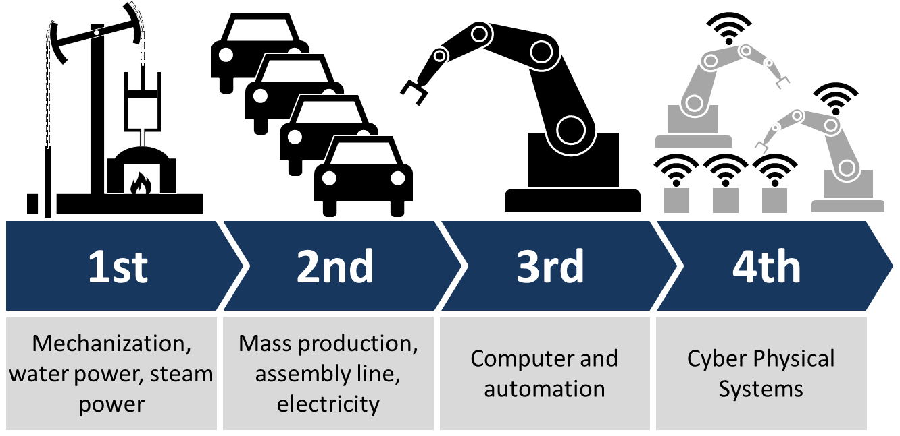
Conversion of the real information into digital? How?
Industrial revolutions and future view [2]

Slide 9
Definition of Cyber-physical Systems (CPS)
"... linking of real (physical) objects and processes with information processing (virtual) objects and processes via open, partly global and always interconnected information networks"
VDI (Association of German Engineers)

Slide 10
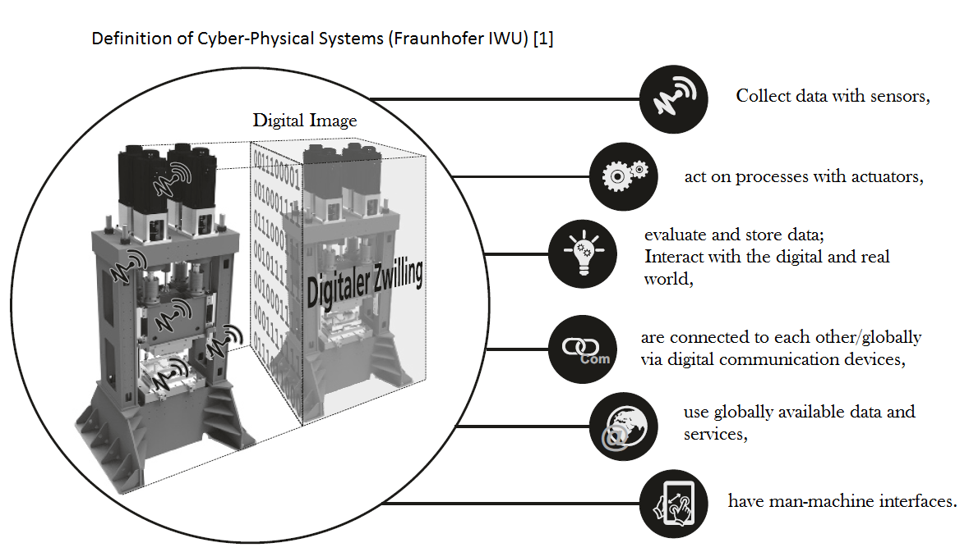

Slide 11
What is meant by IoT? Relationship between IoT and CPS?
CPSs are not IoTs, but you can build them with CPSs.
The internet of things (IoT) is a difficult concept to define precisely.
The internet of things is a computing concept that describes the idea of everyday physical objects being connected to the internet and being able to identify themselves to other devices.
Which goal is to be reach by networking and communicating the individual systems depends on the requirements of the overall system.

Slide 12
What is particularly important in cyber-physical systems (CPS)?
A cyber-physical system represents the desired unity of reality and digital image.
A further development of the mechatronics to a symbiotic system approach on the basis of information technology.
Sensory, actuatorial and cognitive functions can be integrated into technical systems.
Networkability of all components

Slide 13
The basis for fascinating perspectives of technical systems [3]. Functionalities that have so far only been fulfilled by biological systems:
Autonomous Systems: These systems independently solve complex tasks within of a particular application domain.
Dynamically Networked Systems (System-of-Systems): The degree of system networking will increase. This will result in new, more complex systems, their functionality and performance exceeds the sum of the individual systems.

Slide 14
Interactive Sociotechnical Systems: Opens up new perspectives on the interaction between human beings and the Machine. The systems will flexibly adapt to the needs of the user.
Product-service Systems : Enables the fusion of material and process services for customer-oriented problem solutions.

Slide 15
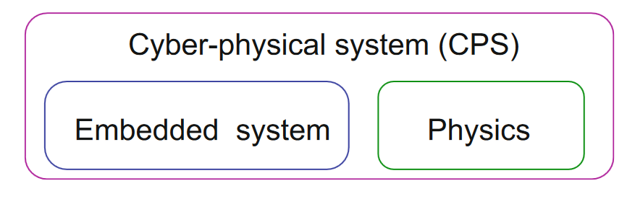
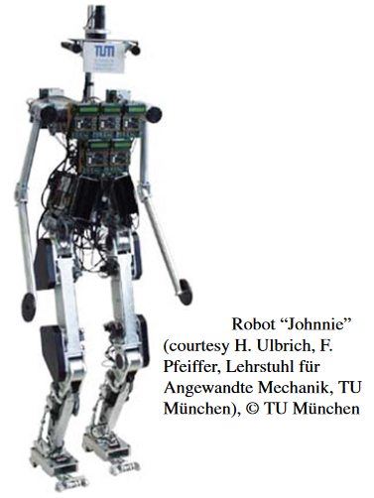
What is the technical basis of the CPSs?
Embedded Systems Design, Peter Marwedel, ISBN 978-3-319-56043-4
Relationship between embedded systems and CPS[4]
Robotics is also a traditional area in which embedded/cyber-physical
systems have been used. Mechanical aspects are very important for robots. Robots, modeled after animals or human beings, have been designed. [4]

Slide 16
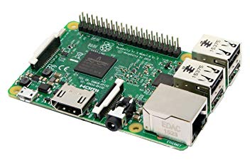
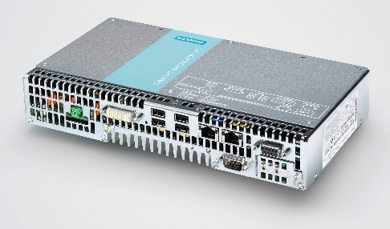
Definition of Embedded Systems (ES)
IEEE has the following definition for embedded systems: An Embedded Computer System: A computer system that is part of a larger system and performs some of the requirements of that system; for example, a computer system used in an aircraft or rapid transit system.
(Institute of Electrical and Electronics Engineers, 1992)
Raspberry Pi 3
Simatic Microbox PC 427B von Siemens

Slide 17
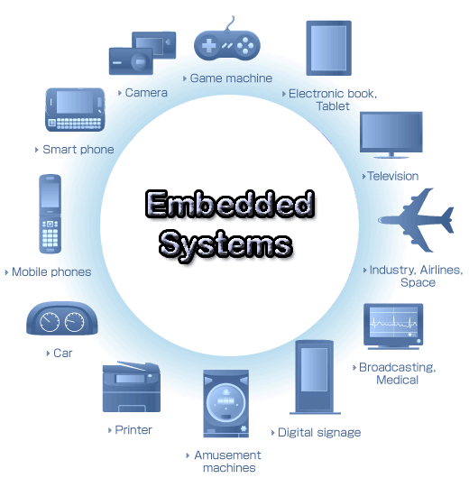
Examples of Applications of ESs:
Automotive Technology :
ABS (Anti-Lock Braking System)
Adaptive Bend Lighting
ESP (Electronic Stability Program)
Electronic Injection System
Navigation System
Infotainment
Cruise Control
Drive by Wire
Medicine Technology:
Surveillance Systems
(Monitoring)
Electronic gas dosing
Glucose Testers
Infusion Pumps
Respirators
Incubators
EEG Systems
ECG System
Automation Technology:
Process control
robotics
Sensor/Actuator Interface
Bluetooth
Buses: Profibus, DeviceNet CANopen, Interbus
e-wire systems
Consumer Goods:
CCD Cameras
Smartphones
MP3 Player
Smarthome Devices
TVs
CD/DVD Systems
Washing Machines
Aircraft Technology:
Autopilot
Artificial Horizon
Tail Stabilizer Bars
Wing Dynamics
Infotainment
Engine Control
Mechatronic Monitoring
Image: https://www.quora.com/What-is-an-embedded-system

Slide 18
Main Features of Embedded Computer Systems
Dedicated Function within a larger mechanical or electrical system.
Response Behavior: Realtime, Hard Realtime, i.e. reaction time to requirements/changes.
Fixed Restrictions: size, performance, power, costs.

Slide 19
Internet and Cyber Security
Cyber security is the basis for successful digitization to protect systems such as
digital production (industry 4.0),
smart energy supply,
logistics and mobility,
health care,
public administration
or cloud-based services.

Slide 20
The most important protection goals:
Integrity
Confidentiality
Availability
Digitisation and networking and the associated link between the digital and physical worlds make it difficult and complex to reach these goals.
In order to avoid economic and social damage, these points must be guaranteed and must be considered depending on the applications.

Slide 21
Safety und security technical systems. How?
Absolutely closed system? It is not possible!
Example Connected Car:
Attacks via media interfaces (Bluetooth, USB, WLAN-Hotspots)
Influencing vehicle sensors and Car2X communication
Attacks during physical access to the vehicle
Attacks on backend systems via web (e.g. Smartphone Vehicle Apps)
https://www.it-daily.net/it-sicherheit/cyber-defence/18736-die-groessten-gefahren-fuer-die-it-sicherheit-im-connected-car

Slide 22
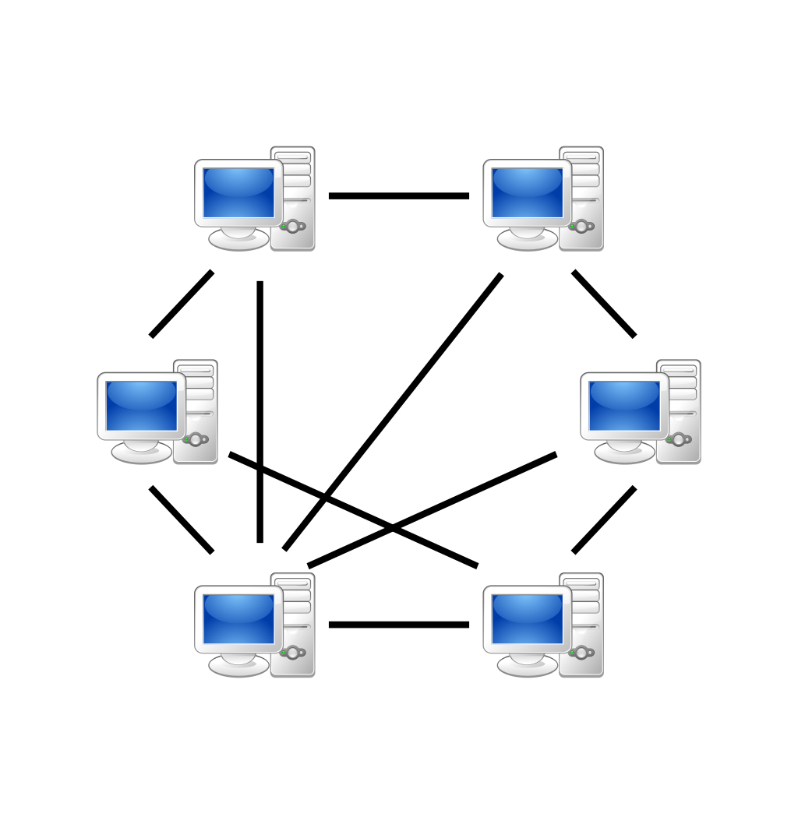
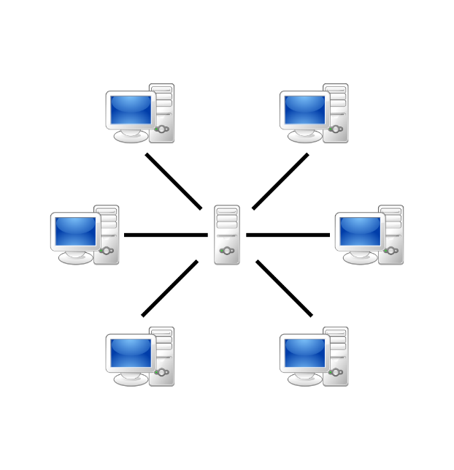
The Internet is a public space! What does this mean for a secure connection over the Internet?
Two connection types are possible:
Peer-to-peer (P2P) network
Network based on the client-server model
Peers are equally privileged, equipotent participants in the application.
Individual clients request services and resources from centralized servers.
https://en.wikipedia.org/wiki/Peer-to-peer

Slide 23
How can we establish a secure connection?
Using cryptographic network protocols: SSH, HTTPS, etc.
Data integrity: Checking the correctness of the data and data structure
Develop autonomous systems related to connection breakdowns

Slide 24
Division into three working groups for each question: processing time 15 min and presentation of the results 10 min for each group.
Group 1:
What is meant by new industrial revolution?
Group 2:
What advantages does digital transformation
offer the industry?
Group 3:
How can we use the digitalization and CPSs for our test benches?
Notes:
Tafel -> saving time, location-independent cooperation, project management, Monitoring development, Coordination of tasks, Scientific added value

Slide 25



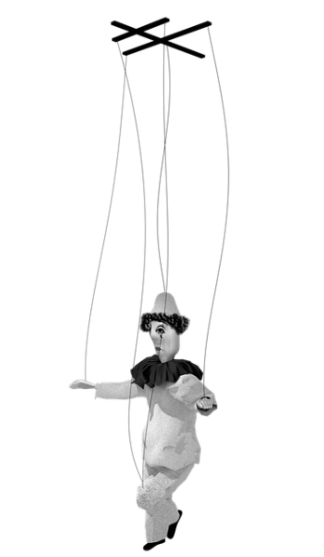
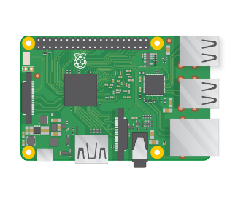
Cyber-physical Test Benches Remotely Controlled via Internet
Transfer digital data …
Server
Remote Control
Peer-to-Peer (P2P)
and encrypted…
Converting to digital object…
Data acquisition and Controlling via a cyber-physical
system

Slide 26
Lunch Break! See you soon…

Slide 27
Technical Environment in Karlsruhe
Current Projects and Test Benches in Karlsruhe
Used Sensor / Actuator Interfaces
Network / Internet
Open-Source and GitHub
Groub Work + Discussion about results

Slide 28
Current Projects HS-UMP
Remote Control Chain Saw Denis
Environmental Chamber Bruchsal
Remote Control/Monitoring Energy Flows CHP
Robot Hand?
Load Station?

Slide 29
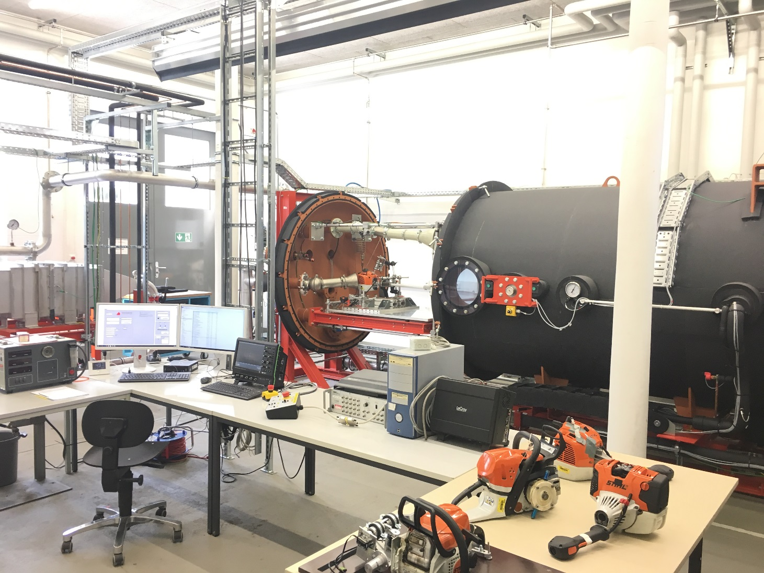
Environmental Chamber Bruchsal
Artur Martel, Arsema Derbie, Dennis Weierter

Slide 30
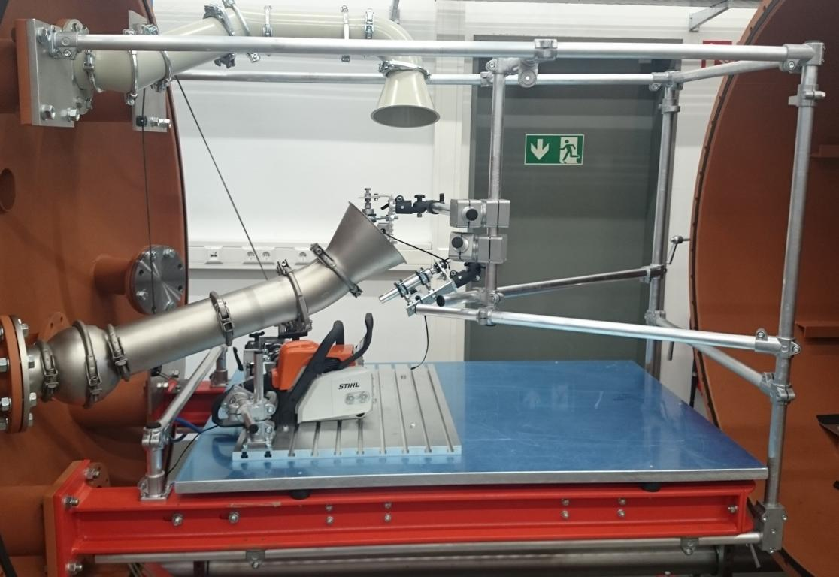
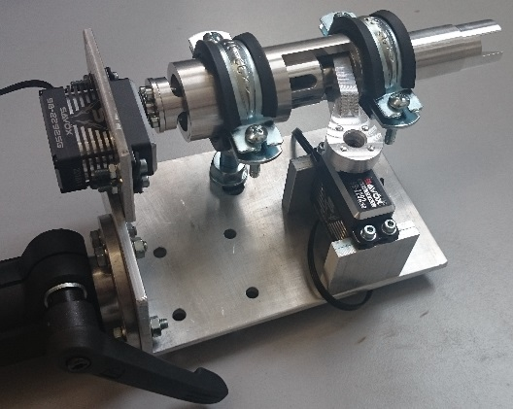
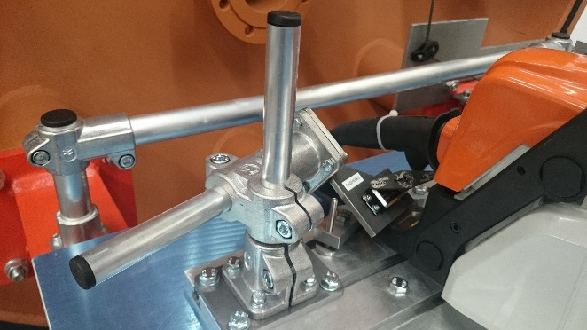
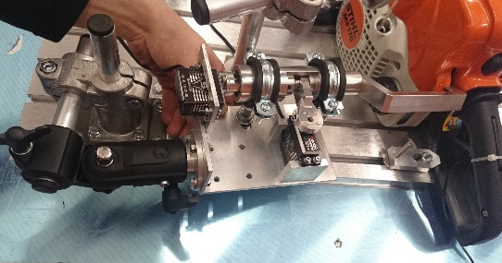
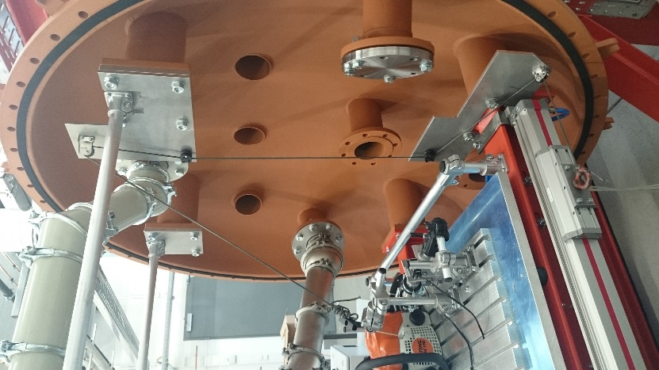
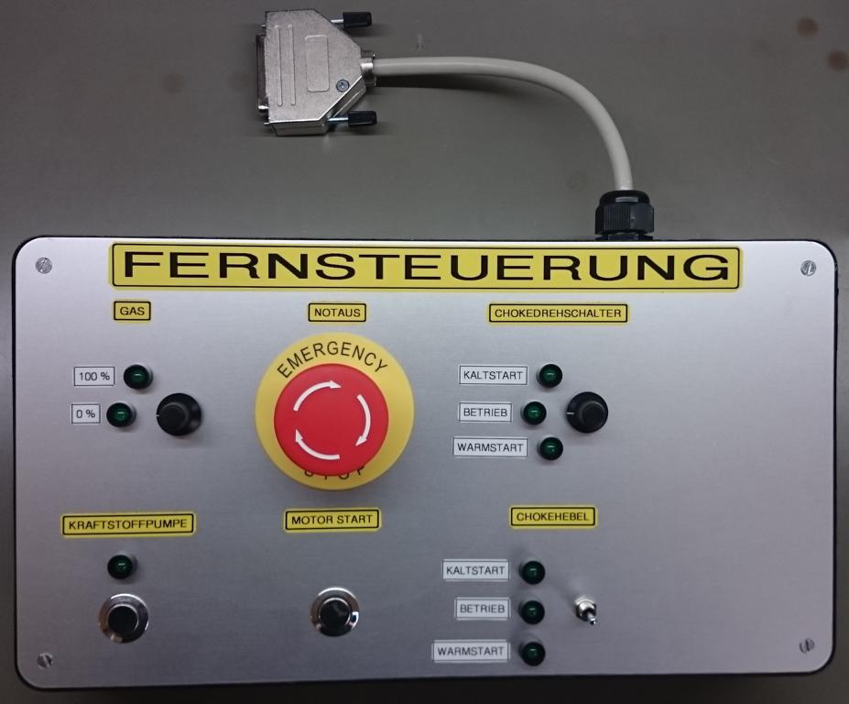
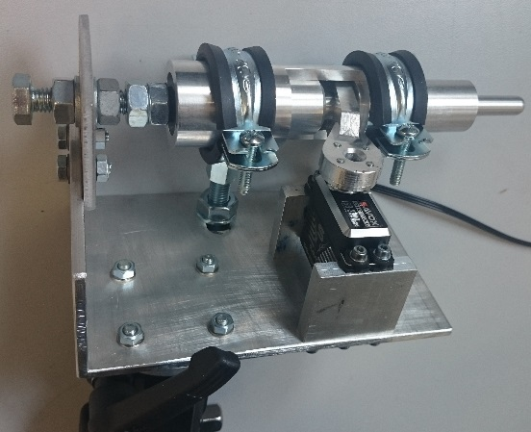
Remote Control Chain Saw
Dennis Weierter

Slide 31
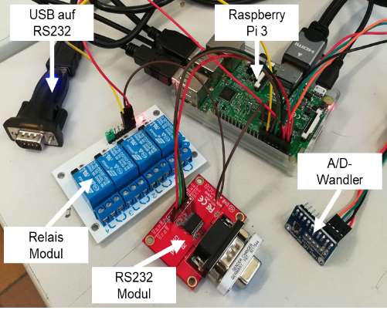

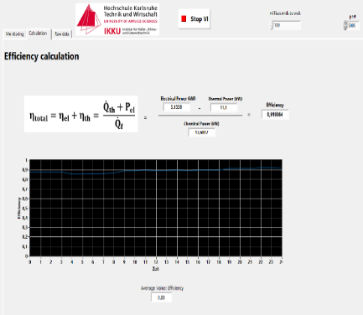
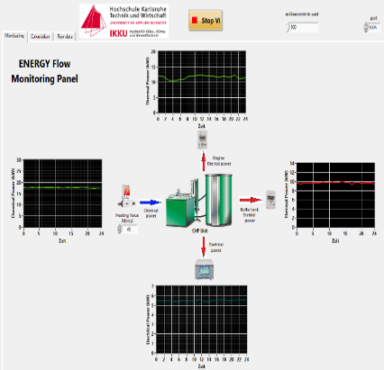
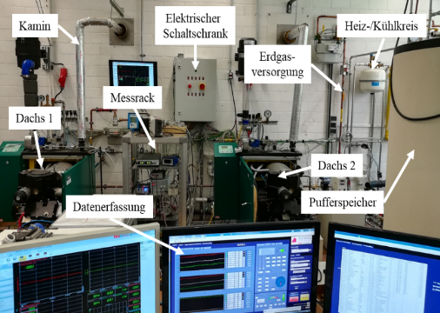
CHP Efficiency
Mitchell Enrique Kuansin, Ferhat Aslan
https://github.com/IKKUengine/CHPefficiency (Python)
06.11.17
| 13

Slide 32
Simulated CPS LabVIEW Energy System Ferhat Aslan https://github.com/IKKUengine/SimulatedCPSLabVIEWEnergySystem (LabVIEW)

Slide 33
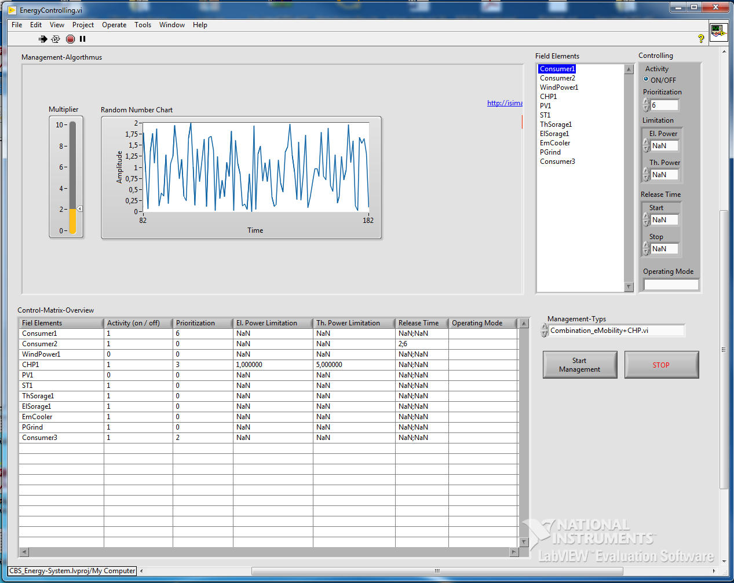
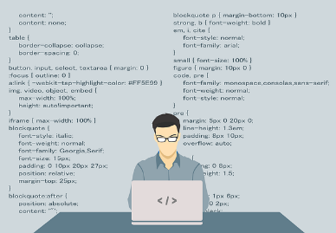
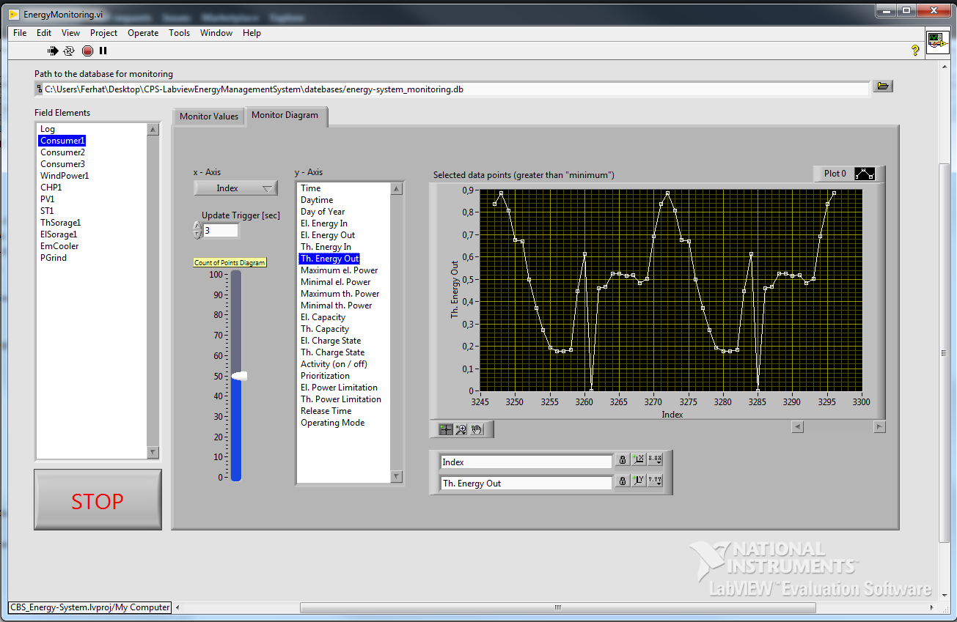
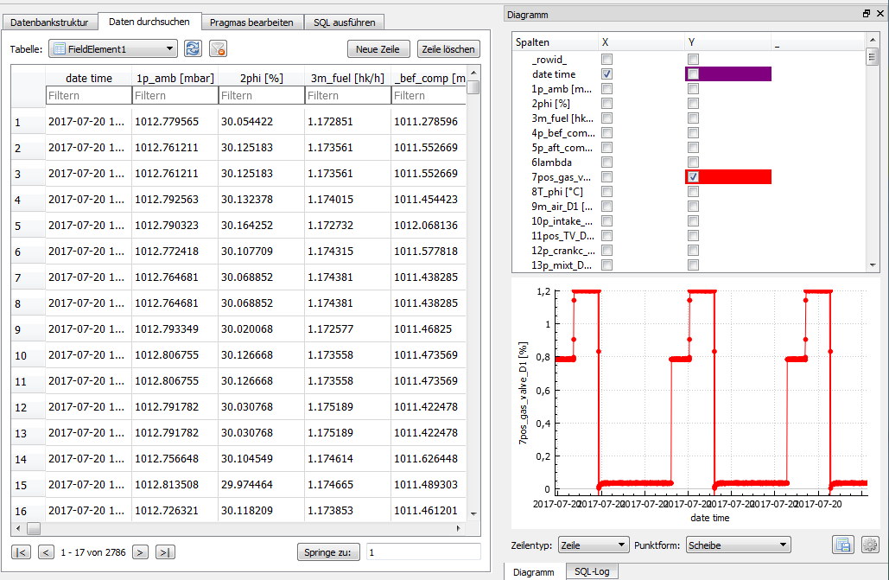


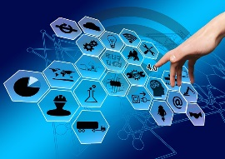

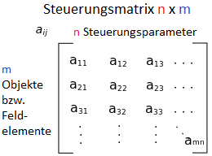
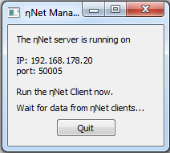
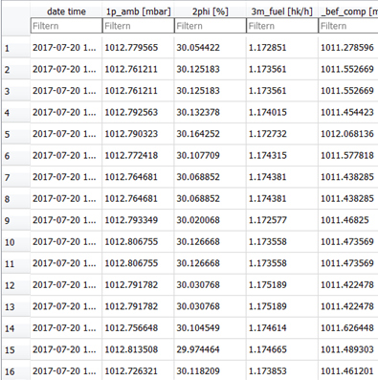


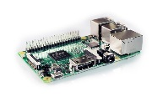
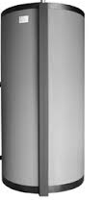


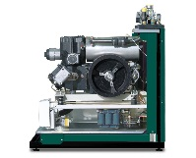
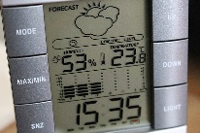
OOP-oriented Programming Paradigm
Management Interface
Monitoring
Handler
Data Collector
Cyber-Physical Objects
Producer
Consumer
Storage

Slide 34
Opens different possibilities:
Design of the visualization and usability of energy flows of combined heat and power units (CHPs) on a touch screen.
Integration of weather data
Conception of the management of BHKWs for the eMobility (charging station)
Development and integration of an electrical storage device
Control of test benches and energy systems via the Internet

Slide 35
Used Sensor / Actuator Interfaces

Slide 36
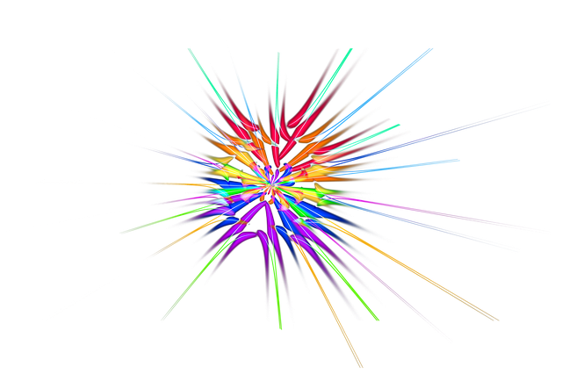



How can we work together in the future?

Slide 37
Division into three working groups for each question: processing time 15 min and presentation of the results 10 min for each group.
Group 1:
What is the benefit of GitHub?
Group 2:
Differences in used programming languages and development environments?
Group 3:
What can we do together to establish an active
cooperation?

Slide 38

Software Publications
https://github.com/IKKUengine/SimulatedCPSLabVIEWEnergySystem (LabVIEW)
https://github.com/IKKUengine/CHPefficiency (Python)
Will follow soon:
https://github.com/IKKUengine/SingleServerCHPefficiency (LabVIEW)
https://github.com/IKKUengine/ThreadedEtaNetServer (C++/Qt5.8)
https://github.com/IKKUengine/CPOEtaNetClient (C++/Qt5.8)
GitHub.com/ikkuengine

Slide 39
Dankeschön…
Contact
Ferhat Aslan
Institut für Kälte-, Klima- und Umwelttechnik
Tel.: 0721 925-1815
Raum M-U07
E-Mail: ferhat.aslan@hs-karlsruhe.de
Prof. Dr.-Ing. Maurice Kettner
Fakultät für Maschinenbau und Mechatronik
Tel.: 0721 925-1845
Raum F-111
E-Mail: maurice.kettner@hs-karlsruhe.de

